Slide 1
Chapter 2 Introduction to Operating Systems
Chien-Chung Shen
CIS/UD
cshen@udel.edu

Slide 2
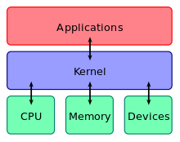
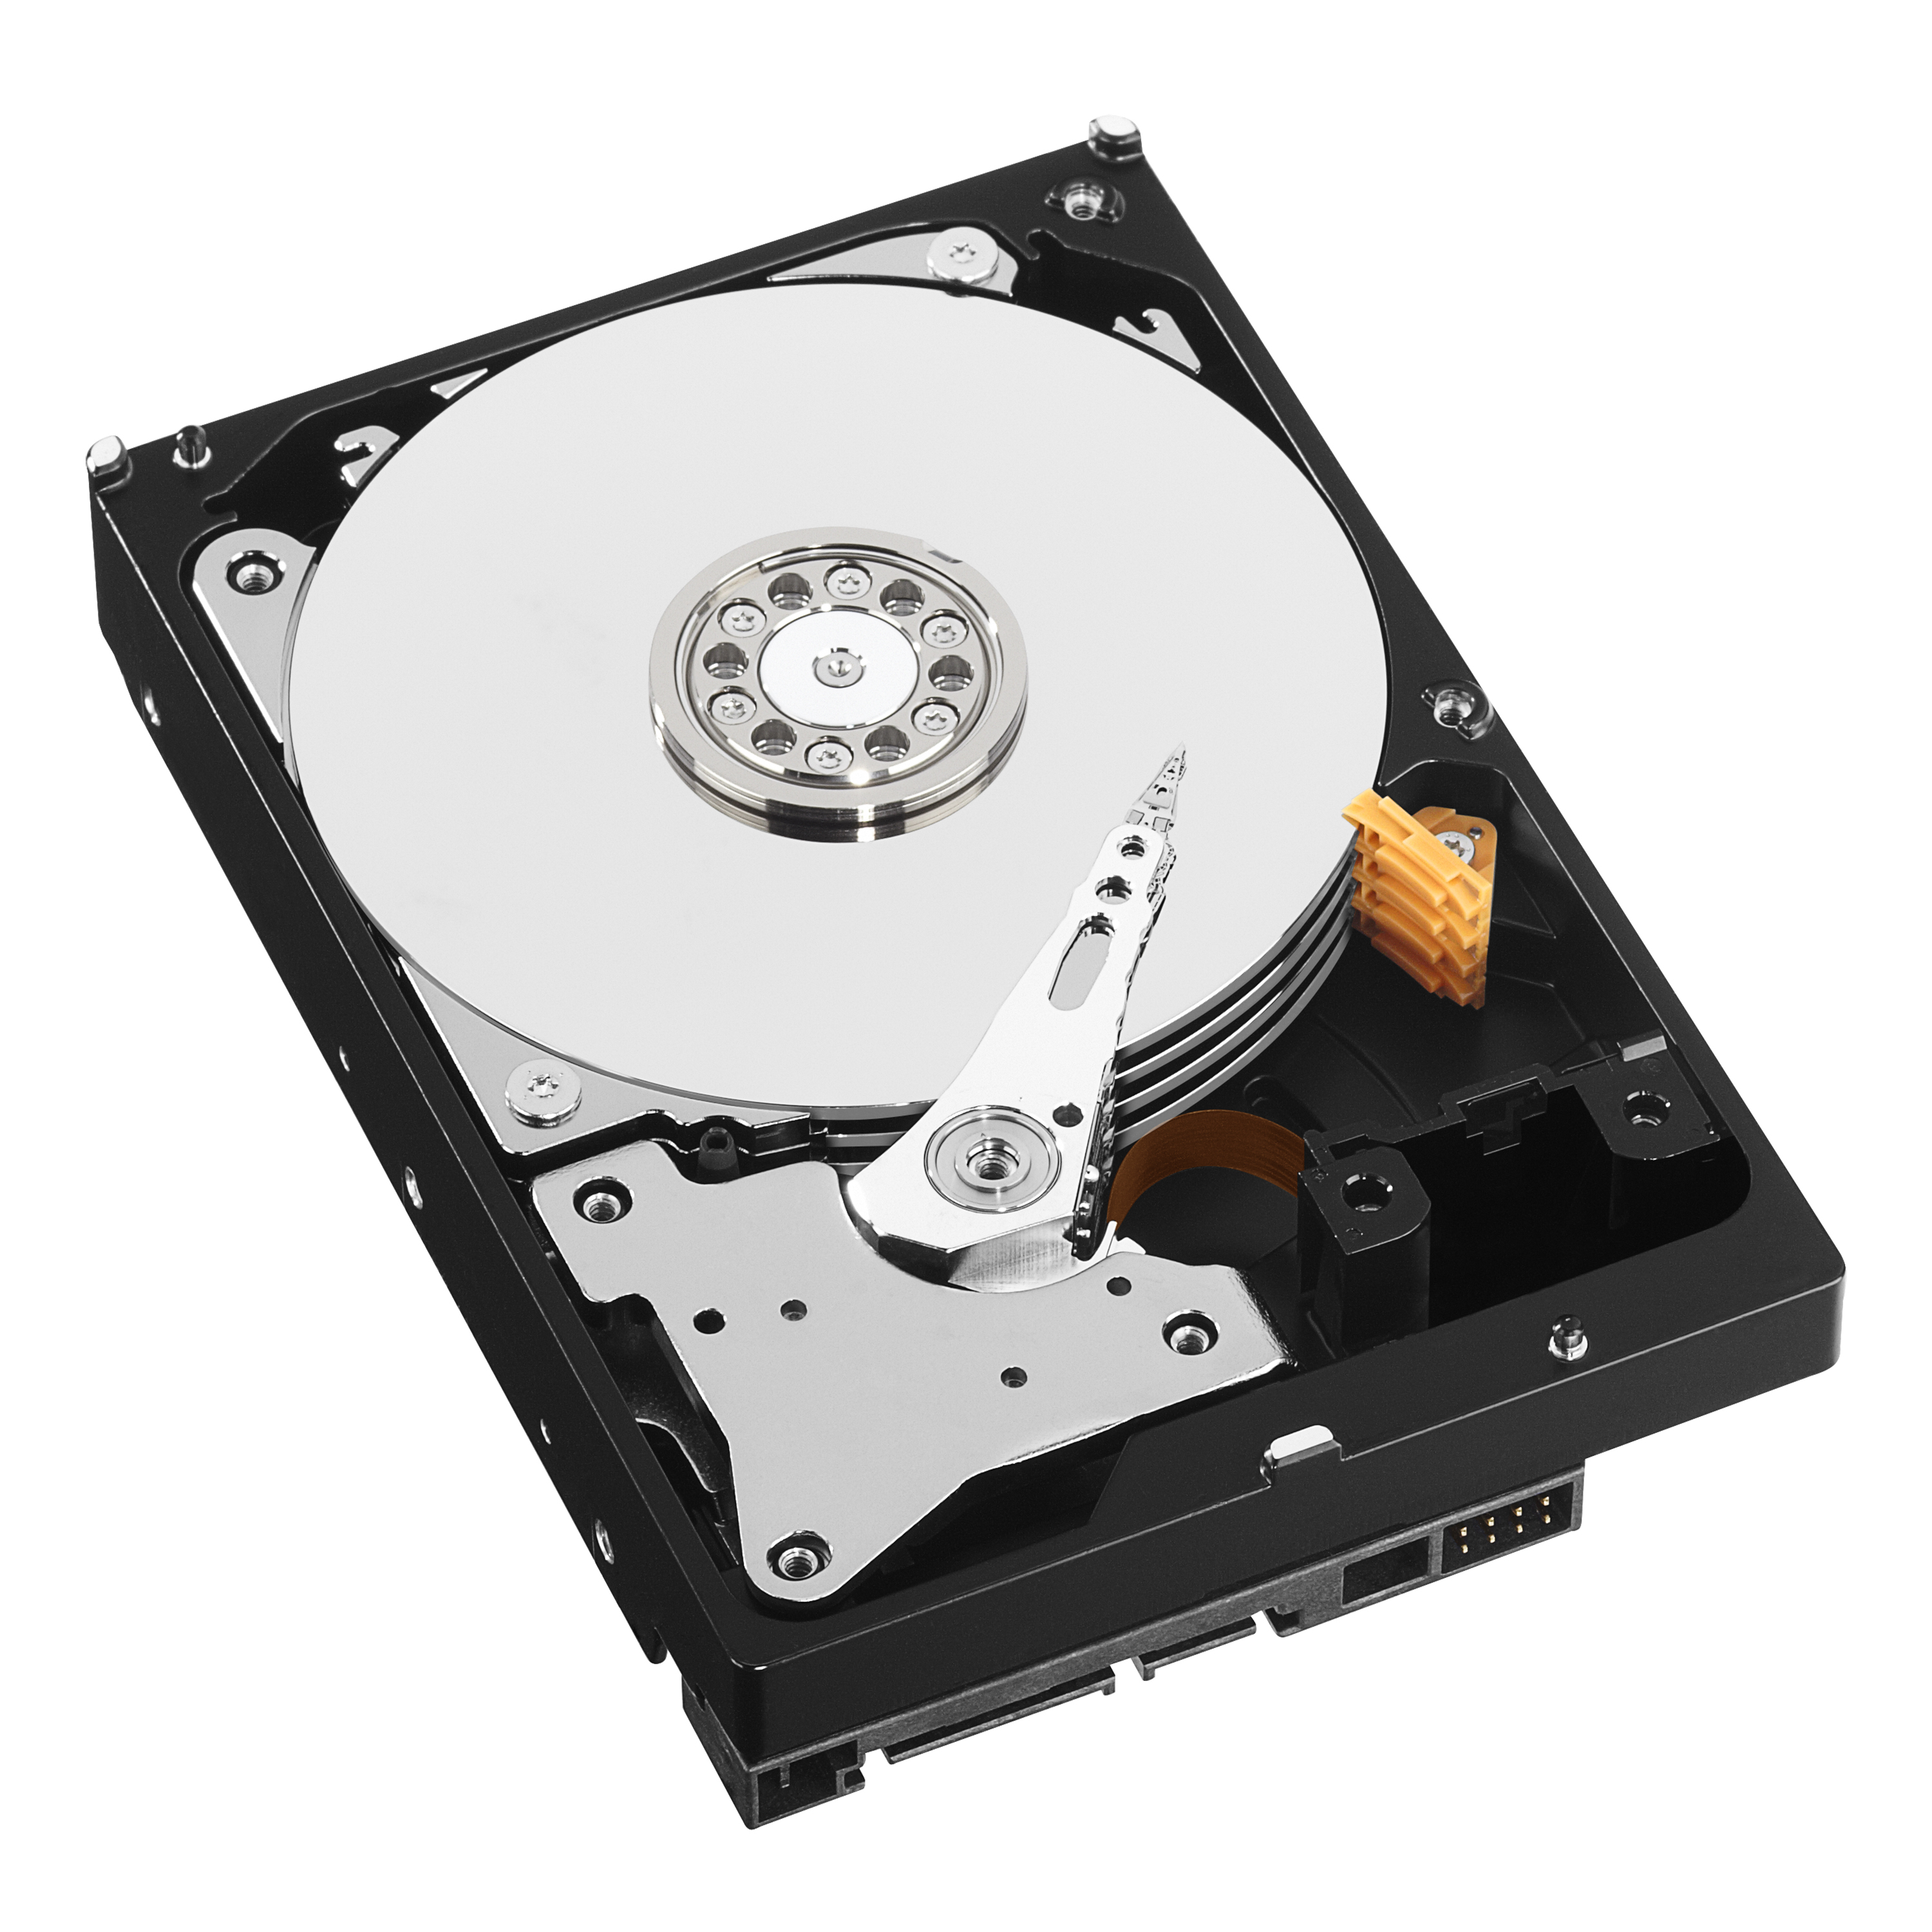
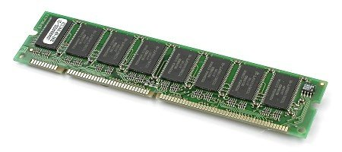

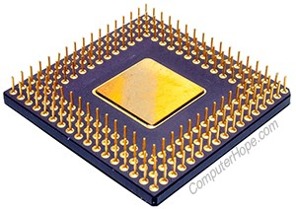
Operating Systems
Goal?
To make computer systems easy to use
run many programs at the same time
allow programs to share the memory
enable programs to interact with devices
etc.
Operating System

Slide 3
Operating Systems
How? (one word beginning with v)
Virtualization – take a physical resource (e.g., processor, memory, or disk) and transform it into a more general, powerful, and easy-to-use virtual form of itself
Because of virtualization, OS behaves as resource manager
Operating System

Slide 4
Virtualizing the CPU
Experiment
code cpu.c and common.h
./cpu A & ; ./cpu B &; ./cpu C &; ./cpu D &
what do you observe?
four programs seem to be running at the same time
OS, with some help from the hardware, provides the illusion that the system has a very large number of “virtual” CPUs
How?
via process and time-sharing

Slide 5
Virtualizing Memory
Experiment
mem.c (with address-space randomization disabled)
in bash, ./mem 11 & ./mem 222 &
others, ./mem 11 & ; ./mem 222 &
what do you observe?
two programs seem to occupy the same memory location
OS, with some help from the hardware, provides the illusion that each running program (process) has its private (physical) memory
How?
via address space and address mapping

Slide 6
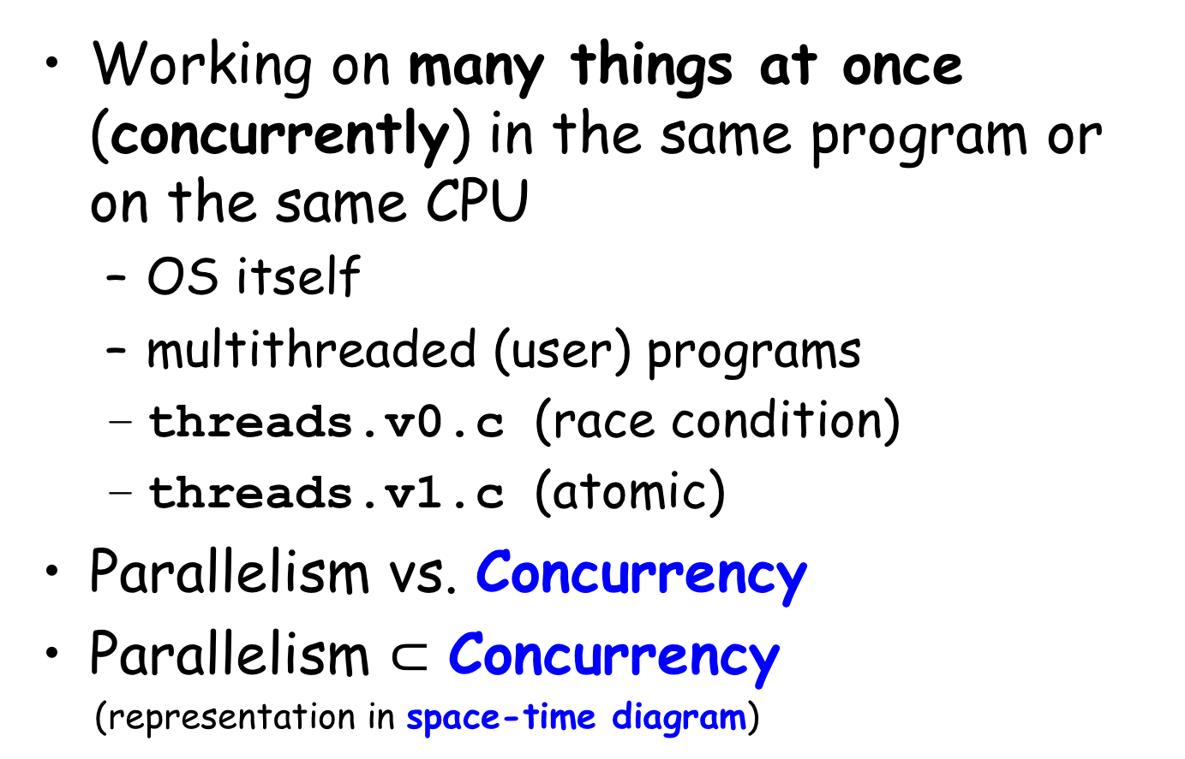
Concurrency
Working on many things at once (concurrently) in the same program or on the same CPU
OS itself
multithreaded (user) programs
threads.v0.c (race condition)
threads.v1.c (atomic)
Parallelism vs. Concurrency
Parallelism $⊂$ Concurrency
(representation in space-time diagram)
P
C

Slide 7
Persistence
DRAM is volatile – when power goes away or system crashes, data in memory is lost
Need hardware and software to store data persistently
I/O devices: hard disk and solid-state drive (SSD)
File system (the part of OS that manages disk/SSD and files)
No virtualization, but sharing of files
io.c: open()/write()/close() system calls to OS file system
Device driver: use I/O commends to interact with the real devices

Slide 8
Design Goals of OS
What OS does
virtualize processor and memory
concurrency
persistency
Build abstractions (process and address space) to make system easy to use (but not at any cost)
Provide high performance (minimize OS overhead)
Provide protection between applications via isolation
Reliability
Energy efficiency
Security
Mobility

Slide 9
Abstraction
Abstractions are fundamental to everything we do in computer science. Abstraction makes it possible
to write a large program by dividing it into small and understandable pieces
to write such a program in a high-level language like C without thinking about assembly
to write code in assembly without thinking about logic gates
to build a processor out of gates without thinking too much about transistors
etc.
Prof. Barbara Liskov's Turning Award lecture: The Power of Abstraction

